Slide 1
Design and Analysis of Algorithms
Text Book :
Fundamentals of Computer Algorithms, Ellis Horowitz, Satraj sahni and Rajashekaram, Galgotia publications pvt. Ltd.

Slide 2
Unit-I

Slide 3
Algorithm
Definition
An algorithm is a finite set of instructions that performs a particular task.
Characteristics of an algorithm.
  Input : Each algorithm must take zero or more number of inputs.
  Output : Each algorithm should produce one or more outputs.
  Definiteness : Each instruction is clear and unambiguous.
  Statements such as “add 6 or 7 to x”
  or
  “Compute 5/0” are not permitted”

Slide 4
  4. Finiteness : The algorithm should terminate after a finite number of steps.
  5. Effectiveness : Each step must be effective, and can be performed exactly in a finite amount of time.

Slide 5
Pseudo code for expressing algorithms
We present most of our algorithms using pseudo code that looks like C and Pascal code.
  Comments begin with // and continue until end of the line.
  Blocks are indicated with matching braces: { and }.
      A compound statement.
      Body of a function.

Slide 6
  3. i). An identifier begins with a letter.
    ii). The data types of variables are not explicitly declared.
    iii). The types will be clear from the context.
    iv). Whether a variable is global or local to a function will also be clear from the context.
    v). We assume simple data types such as integer, float, char, boolean, and so on.
    vi). Compound data types can be formed with records.

Slide 7
node = record
{
datatype_1 data_1;
:
datatype_n data_n;
node *link
}
data items of a record can be accessed
with → and period( . )
C style :-
struct node
{
datatype_1 data_1;
:
datatype_n data_n;
struct node *link
}

Slide 8
  4. Assignment of values to variables is done using the assignment statement.
  < variable > := < expression >
  5. There are two boolean values true and false. To produce these values, logical operators and, or and not and the relational operators <, ≤, =, ≠, ≥ and > are provided.
  6. Elements of multidimensional arrays are accessed using [ and ]. For example the (i,j)th element of the array A is denoted as A[i,j].
  7. The following looping statements are used: for, while, and repeat until.

Slide 9
The general form of a while loop:
while( condition ) do
{
statement_1;
:
statement_n;
}

Slide 10
The general form of a for loop:
for variable := value1 to value2 step step do
{
statement_1;
:
statement_n;
}
  Here value1, value2, and step are arithmetic expressions.
  The clause “step step” is optional and taken as +1 if it does not occur.
  step could be either positive or negative.
  Ex: 1: for i:= 1 to 10 step 2 do // increment by 2, 5 iterations
  2: for i:= 1 to 10 do // increment by 1, 10 iterations

Slide 11
  The for loop can be implemented as a
  while loop as follows:
  variable:=value1;
  incr:=step;
  while( ( variable – value2)*step ≤ 0 ) do
  {
  <statement 1>
  :
  <statement n>
  variable :=variable+incr;
  }

Slide 12
The general form of a repeat-until loop:
  repeat
  <statement 1>
  :
  <statement n>
  until ( condition )
The statements are executed as long as condition is false.
Ex: sum:=0, n:=10;
repeat
sum := sum + number;
number := number - 1;
until number = 0;

Slide 13
  8. A conditional statement has the following
  forms:
  if< condition > then < statement >
  if< condition > then < statement 1> else
  < statement 2>
  9. Input and output are done using the instructions read and write.

Slide 14
10. Procedure or function starts with the word
Algorithm.
General form :
Algorithm Name( <parameter list> )
{
body
}
where Name is the name of the procedure.
  Simple variables to functions are passed by value.
  Arrays and records are passed by reference.

Slide 15
Ex:-Algorithm that finds and returns the maximum of n given numbers.
Algorithm max(a,n)
// a is an array of size n
{
result:=a[1];
for i:=2 to n do
if ( a[i] > result ) then
result:=a[i];
return result;
}

Slide 16
Ex:-Write an algorithm to find sum of n numbers
Algorithm sum(a, n)
// a is an array of size n
{ sum:=0;
for i :=1 to n do
{
sum := sum+a[i];
}
return sum;
}

Slide 17
Space Complexity
The space needed by an algorithm is called a space complexity.
It has the following components.
  Instruction space / Program space
    It does not depend on the number of inputs.( Instance characteristics of a problem ).
  Data space
    Constants & simple variables – Don’t depend on the number of inputs.
    Dynamically allocated objects - Depends on the number of inputs.
    Stack space - Generally does not depend on the number of inputs unless recursive functions are in use.

Slide 18
Recursive algorithm
Algorithm rfactorial(n)
// n is an integer
{ fact=1;
if(n=1 or n=0) return fact;
else
fact=n*rfactorial(n-1);
return fact;
}
Note : Each time the recursive function is called, the current values of n, fact and the address of the next statement to return to on completion are saved on the stack.

Slide 19
Execution
n : 2
R:
n : 3
int rfactorial(n){
fact=1
if (n=0 or n=1)return fact
else
fact=n*rfactorial(n-1);
return fact;
}
void main()
{int R=rfactorial(3);
printf(R);}
int rfactorial(n){
fact=1;
if (n=0 or n=1)return fact;
else
fact=n*rfactorial(n-1);
return fact;
}
location to return
n : 1
fact
1
int rfactorial(n){
if (n=0 or n=1)
return 1;
else
fact=n*rfactorial(n-1);
return fact;
}
n
1
fact=1
4000
1
fact=2*
fact
2
n
3000
1
fact
3
fact=3*
n
2000
R
Stack

Slide 20
Contd..
  Therefore, We can divide the total space required by a
  program into two parts:
i) Fixed Space Requirements (C)
Independent of the characteristics of the problem instance ( I )
    Instruction space
    Space for simple variables and constants.
  ii) Variable Space Requirements (S_{P}(I))
  depend on the characteristics of the problem instance ( I )
    Number of inputs associated with I
    Recursive stack space ( formal parameters, local variables, return address ).
  Therefore, the space requirement of any problem P can be written as
  S(p)=C +S_{p}( Instance characteristics ).

Slide 21
Note:
  We concentrate only on estimating
  S_{p} (Instance characteristics ).
  We don’t concentrate on estimating fixed part c .
  We need to identify the instance characteristics of the problem to measure S_{p}

Slide 22
Example1
Algorithm abc(a,b,c)
{
return a+b+b*c+(a+b-c)/(a+b)+4.0;
}
Problem instance characterized by the specific values of a,b,and c.
If we assume one word (4 bytes) is adequate to store the values of each a, b, and c , then the space required by abc is independent of the instance characteristics.
Therefore, S_{abc}( instance characteristics)=0

Slide 23
Example2
Algorithm sum(a,n)
{
s:=0;
for i:=1 to n do
s:=s+a[i];
return s;
}
Problem instance characterized by n.
The amount of space depends on the value of n.
Therefore, S_{sum}(n) = n

Slide 24
Example3
Algorithm RSum(a,n)
{
if(n ≤ 0) then return 0;
else return RSum(a,n-1)+a[n];
}
Type | Name | Number of bytes
formal parameter: int | a | 2
formal parameter: int | n | 2
return address ( used internally) |  | 2
Total per one recursive call |  | 6
Total no.of recursive calls n, therefore S_{RSum} (n)=6n

Slide 25
Contd..
Time Complexity:
T(P)=C+T_{P}(I)
  Time Complexity, T(P) is the sum of its compile time C plus its run time, T_{P}(I).
  Compile time does not depend on the instance characteristics( Number of inputs ).
  We will concentrate on estimating run time T_{p}(I).

Slide 26
If we know the compiler used, then we can find out the
  No. of additions , subtractions, and so on.
Then we can obtain an expression for T_{p}(n) Of the form
  T_{P}(n)=c_{a}ADD(n)+c_{s}SUB(n)+c_{m}MUL(n)+c_{d}DIV(n)+……..
  where,
  c_{a}, c_{s}, c_{m}, c_{d} and so on denote the time required for an addition , subtraction and so on.
  ADD, SUB, MUL, DIV, and so denote no.of additions, subtractions, and so on.

Slide 27
Even with this formula it is not possible to calculate the exact execution time, because time required for an addition, subtraction, and so on, depends an numbers being added, subtracted, and so on.
So, the value of T_{p}(n) for any given n can be obtained only experimentally ( using stopwatch ).
Even with the experimental approach, we face difficulties.
The execution time of a program p depends on the number of other programs running on the computer at the time program p is running.

Slide 28
Contd..
As there are some problems in finding the execution time using earlier methods, we will go one step further and count only the number of program steps.
program step
program step is loosely defined as a syntactically or semantically meaningful program statement whose execution time is independent of the number of inputs.
Example :
c := a + b;
sum := sum + a[i];

Slide 29
The number of steps contributed by any program statement depends on the kind of statement.
Comments are counted as zero number of steps.
An assignment statement which does not involve any function calls to other functions counted as one step.
For loops, such as the for, while, and repeat-until, we consider the step counts only for the control part of the statement.
The control parts for for and while statements have the following forms:
  for i:= <expr1> to <expr2> do
  while ( <expr> ) do

Slide 30
Each execution of the control part of a while statement is one, unless <expr> is a function of instance characteristics.
Similarly, each execution of the control part of a for statement is one, unless <expr1> and <expr2> are functions of the instance characteristics.
Each execution of the condition of a conditional statements step count is one, unless condition is a function of instance characteristics.
If any statement ( assignment statement, control part, condition etc.) involves function calls, then the step count is equal to the number of steps assignable to the function plus one.

Slide 31
Methods to compute the step count
  1) Introduce global variable count into the program with initial value zero.
    Statements to increment count by the appropriate amount are introduced.
    The value of the count at the time program terminates is the number steps contributed by the program.
  2) Tabular method
    Determine the number of steps contributed by each statement per execution × frequency ( number of times stmt is executed ).
    Add up the contribution of all statements

Slide 32
Method-I: Introduce variable count into programs
EX:- Iterative sum of n numbers
Algorithm sum(a, n)
{
s:=0;
  count:=count+1; // for assignment statement
for i:=1 to n do
{ count:=count+1; // For for
s:=s+a[i];
count:=count+1; // for assignment statement
}
count:=count+1; // for last time of for
return s;
count:=count+1; // for return
}
2n + 3 steps
Note : Step count tells us how the run time for a program changes with
changes in the instance characteristics.

Slide 33
Ex:- Addition of two m×n matrices
Algorithm Add(a,b,c,,m,n)
{
  for i:=1 to m do
  {
  for j:=1 to n do
  {
  c[i,j]:=a[i,j]+b[i,j];
  }
  }
  }
2mn + 2m+1 steps

Slide 34
EX:- Recursive sum of n numbers
Algorithm RSum(a,n)
{
count:=count+1; // for the if conditional
if(n ≤ 0) then
{
return 0;
count:=count+1; // for the return
}
else
{
return RSum(a,n-1)+a[n];
count:=count+1; // For the addition, function invocation and return
}
}

Slide 35
When analyzing a recursive program for its step count, we generally obtain a recursive formula for the step count.
We obtain the following recursive formula for above (RSum) algorithm.
t_{RSum} (n)=
2
If n=0
2+ t_{RSum}(n-1)
If n>0

Slide 36
One of the ways of solving such recursive formula is by repeated substitutions for each occurrence of the function t_{RSum} on the right side until all such occurrences disappear:
t_{RSum} (n) = 2+t_{RSum}(n-1)
= 2+2+t_{RSum}(n-2)
= 2(2)+t_{RSum}(n-2)
:
:
= n(2) +t_{RSum}(n-n)
=2n+t_{RSum}(0)
= 2n+2
The step count for Rsum is 2n+2

Slide 37
Ex : Find out total step count of the following algorithm using method 1
Algorithm display( )
{
  for i := 1 to n do
  {
  for j := 1 to n do
  {
  write ( i, j );
  }
  }
  }
2n² + 2n+1 steps

Slide 38
Method-II: Tabular method
Ex:- Iterative sum of n numbers
Statement | s/e | frequency | Total steps
Algorithm sum(a, n) { s:=0 ; for i:=1 to n do s:=s+a[i]; return s; } | 0 0 1 1 1 1 0 | -- -- 1 n+1 n 1 -- | 0 0 1 n+1 n 1 0
Total |  |  | 2n+3

Slide 39
EX:- Addition of two m×n matrices
Statement | s/e | frequency | Total steps
Algorithm Add(a,b,c,m, n) { for i:=1 to m do for j:=1 to n do c[i,j]:=a[i,j]+b[i,j] ; } | 0 0 1 1 1 0 | -- -- m+1 m(n+1) mn -- | 0 0 m+1 mn+m mn 0
Total |  |  | 2mn+2m+1

Slide 40
Ex:- Recursive sum of n numbers
Statement | s/e | Frequency n=0 n>0 | Total steps n=0 n>0
Algorithm RSum(a,n) { if( n ≤ 0 ) then return 0; else return Rsum(a,n-1)+a[n] ; } | 0 0 1 1 1+x 0 | -- -- -- -- 1 1 1 0 0 1 -- -- | 0 0 0 0 1 1 1 0 0 1+x 0 0
Total |  |  | 2 2+x
x=t_{RSum}(n-1)
Note : See slide 36 for solving this recursive formula.

Slide 41
Summary of Time Complexity
The time complexity of an algorithm is given by the number of program steps taken by the algorithm.
The number of steps is a function of the instance characteristics ( number of inputs ).
Step count tells us how the run time of a program changes with changes in the number of inputs.

Slide 42
Best, Worst, Average Cases
All the inputs of a given size for a given problem, don’t take the same number of program steps.
Sequential search for Key in an array of n integers:
  Begins at the first element in array and look at each element in turn until K is found.
  Algorithm sequentialSrch( a, n, key )
  {
  for i := 1 to n do
  {
  if ( a[ i ] = key )
  { return i; }
  }
  }
Ex : Let us take , a [ ] := { 2, 5, 7, 8, 9 }
Best case, key := 2
Worst case key := 9
Avg Case , if key := 2 , total no.of steps +
if key := 5 , total no.of steps +
if key :=7, total no.of steps +
and so on by total no.of elements ( n) .
Notes:
Best: Find at first position. Cost is 1 compare.
Worst: Find at last position. Cost is n compares.
Average: (n+1)/2 compares IF we assume the element with value K is equally likely to be in any position in the array.

Slide 43
Best-Case Step count:-
Minimum number of steps taken by the algorithm for the given inputs.
2. Worst-Case Step count:-
Maximum number of steps taken by the algorithm for the given inputs.
3.Average-Case Step count:-
Average number of steps taken by an algorithm.

Slide 44
5 ms
Worst -case time
Running
Time
4 ms
3 ms
Best-case time
2 ms
1 ms
A
B
C
D
E
F
G
Input
Average-case time =
A time + B time+ ………..+G time
----------------------------------------------------
7 ( total number of possible inputs )

Slide 45
Inexactness of step count.
  Both the instructions x=y; and x=y+z+(x/y) count as one step.
  Therefore, two analysts may arrive at 4n²+3n+2 and 7n²+6n+4 as the step count for the same program.
  Because of the inexactness of a step count , the exact step count is not very useful for comparison of algorithms.

Slide 46
Asymptotic efficiency
Asymptotic efficiency means study of algorithms efficiency / time complex for large inputs.
To compare two algorithms with running times f(n) and g(n), we need a rough measure that characterizes how fast each function grows as n grows.
Hint: use rate of growth
Compare functions asymptotically!
  (i.e., for large values of n)

Slide 47
Rate of Growth
Ex:- F(n)=n²+100n+log₁₀n+1000
n | f(n) | n² |  | 100n |  | log10n |  | 1000
 | value | Value | % | value | % | value | % | value | %
1 | 1,101 | 1 | 0.1 | 100 | 9.1 | 0 | 0.0 | 1,000 | 90.83
10 | 2,101 | 100 | 4.76 | 1,000 | 47.6 | 1 | 0.05 | 1,000 | 47.60
100 | 21,002 | 10,000 | 47.6 | 10,000 | 47.6 | 2 | 0.001 | 1,000 | 4.76
1,000 | 1,101,003 | 1,000,000 | 90.8 | 100,000 | 9.1 | 3 | 0.0003 | 1,000 | 0.09
10,000 | 101,001,004 | 100,000,000 | 99.0 | 1,000,000 | 0.99 | 4 | 0.0 | 1,000 | 0.001

Slide 48
The low order terms and constants in a function are relatively insignificant for large n
n² + 100n + log₁₀n + 1000 ~ n²
i.e., we say that n² + 100n + log₁₀n + 1000 and n² have the same rate of growth
Some more examples
n⁴ + 100n² + 10n + 50 is ~n⁴
10n³ + 2n² is ~n³
n³ - n² is ~n³
constants
  10 is ~1
  1273 is ~1

Slide 49

Asymptotic Notations
Asymptotic notation describes the behavior of functions for the large inputs.
Big Oh(O) notation:
  The big oh notation specifies an upper bound for the growth rate of the function f.
Definition: [Big “oh’’]
  f(n) = O(g(n)) (read as “f of n is big oh of g of n”) iff there exist positive constants c and n₀ such that
  f(n) ≤ cg(n) for all n, n ≥ n₀.

Slide 50
The definition states that the function f(n) is at most c times the function g(n) except when n is smaller than n₀.
In other words, f(n) grows slower than or same rate as” g(n).
When providing an upper –bound function g for f, we normally use a single term in n.
Examples
  f(n) = 3n+2
    3n + 2 <= 4n, for all n >= 2, ∴ 3n + 2 = Ο (n)
  f(n) = 10n²+4n+2
    10n²+4n+2 <= 11n², for all n >= 5, ∴ 10n²+4n+2 = Ο (n²)
  f(n)=6*2^{n}+n²=O(2^{n}) /* 6*2^{n}+n² ≤ 7*2^{n} for n≥4 */

Slide 51
It also possible to write 10n²+4n+2 = O(n³) since 10n²+4n+2 <= 7n³ for n>=2
Although n³ is an upper bound for 10n²+4n+2, it is not a tight upper bound; we can find a smaller function (n² ) that satisfies big oh relation.
But, we can not write 10n²+4n+2 =O(n), since it does not satisfy the big oh relation for sufficiently large input.
Note : We always consider tight upper bound.

Slide 52

Omega (Ω) notation:
  The omega notation specifies a lower bound for the growth rate of the function f.
Definition: [Omega]
  f(n) = Ω(g(n)) (read as “f of n is omega of g of n”) iff there exist positive constants c and n₀ such that f(n) ≥ cg(n) for all n,
  n ≥ n₀.

Slide 53
The definition states that the function f(n) is at least c times the function g(n) except when n is smaller than n₀.
In other words,f(n) grows faster than or same rate as” g(n).
Examples
  f(n) = 3n+2
    3n + 2 >= 3n, for all n >= 1, ∴3n + 2 = Ω (n)
  f(n) = 10n²+4n+2
    10n²+4n+2 >= n², for all n >= 1, ∴ 10n²+4n+2 = Ω (n²)
It also possible to write 10n²+4n+2 = Ω(n) since 10n²+4n+2 >=n for n>=0

Slide 54
Although n is a lower bound for 10n²+4n+2, it is not a tight lower bound; we can find a larger function (n² )that satisfies omega relation.
But, we can not write 10n²+4n+2 = Ω(n³), since it does not satisfy the omega relation for sufficiently large input.
Note : We always consider tight lower bound.

Slide 55

Theta (Θ) notation:
  The Theta notation specifies the tight upper and lower bounds for the growth rate of the function f.
Definition: [Theta]
  f(n) = Θ(g(n)) (read as “f of n is theta of g of n”) iff there exist positive constants c₁, c₂, and n₀ such that c₁g(n) ≤ f(n) ≤ c₂g(n) for all n, n ≥ n₀.

Slide 56
The definition states that the function f(n) lies between c1 times the function g(n) and c2 times the function g(n) except when n is smaller than n₀.
In other words, f(n) grows same rate as” g(n).
Examples:-
  f(n) = 3n+2
    3n <= 3n + 2 <= 4n, for all n >= 2, ∴ 3n + 2 = Θ (n)
  f(n) = 10n²+4n+2
    n²<= 10n²+4n+2 <= 11n², for all n >= 5, ∴ 10n²+4n+2 = Θ (n²)
But, we can not write either 10n²+4n+2= Θ(n) or 10n²+4n+2= Θ(n³), since neither of these will satisfy the theta relation.

Slide 57
Little Oh(O) notation:
  The little oh notation specifies a strict upper bound for the growth rate of the function f.
Definition: [Little “oh’’]
  f(n) = o(g(n)) (read as “f of n is little oh of g of n”) iff
Lim
n->∞
f(n)
= 0
g(n)

Slide 58
The definition states that the function f(n) is less than c times the function g(n) except when n is smaller than n₀.
In other words, f(n) grows slower than” g(n).
Examples
  f(n) = 3n+2=o(n²)
    since
  However, 3n+2 ≠ o(n)
Lim
n->∞
3n+2
= 0
n²

Slide 59
Big-Oh, Theta, Omega and Little-oh
Tips :
Think of O(g(n)) as “less than or equal to” g(n)
  Upper bound: “grows slower than or same rate as” g(n)
Think of Ω(g(n)) as “greater than or equal to” g(n)
  Lower bound: “grows faster than or same rate as” g(n)
Think of Θ(g(n)) as “equal to” g(n)
  “Tight” bound: same growth rate
Think of o(g(n)) as “less than to” g(n)
  Strict Upper bound: “grows slower than ” g(n)
(True for large N)

Slide 60
Functions ordered by growth rate
Function | Name
1 | Growth is constant
logn | Growth is logarithmic
n | Growth is linear
nlogn | Growth is n-log-n
n² | Growth is quadratic
n³ | Growth is cubic
2^{n} | Growth is exponential
n! | Growth is factorial
1 < logn < n < nlogn < n² < n³ < 2^{n} < n!

Slide 61
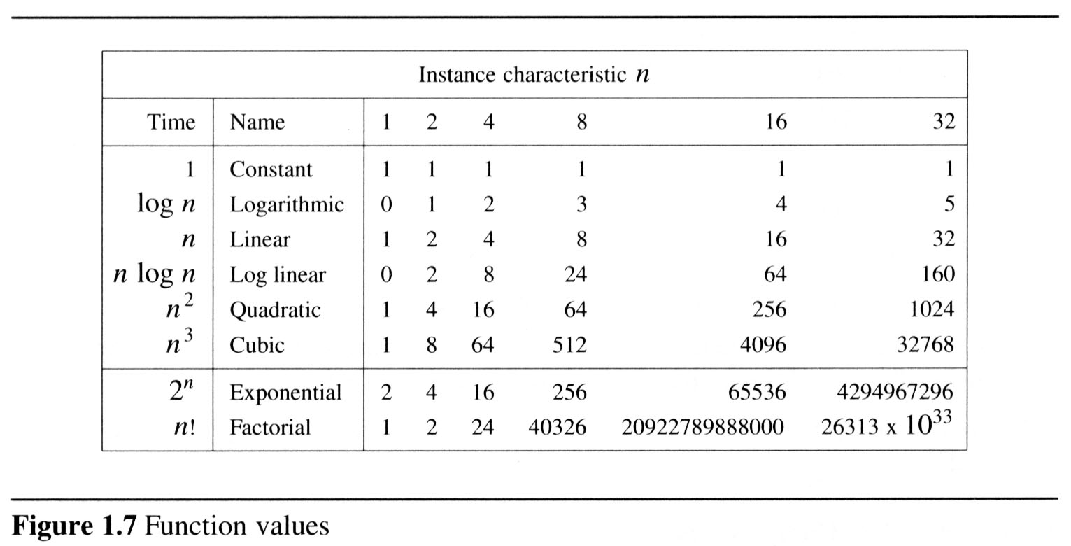
  To get a feel for how the various functions grow with n, you are advised to study the following figs:

Slide 62
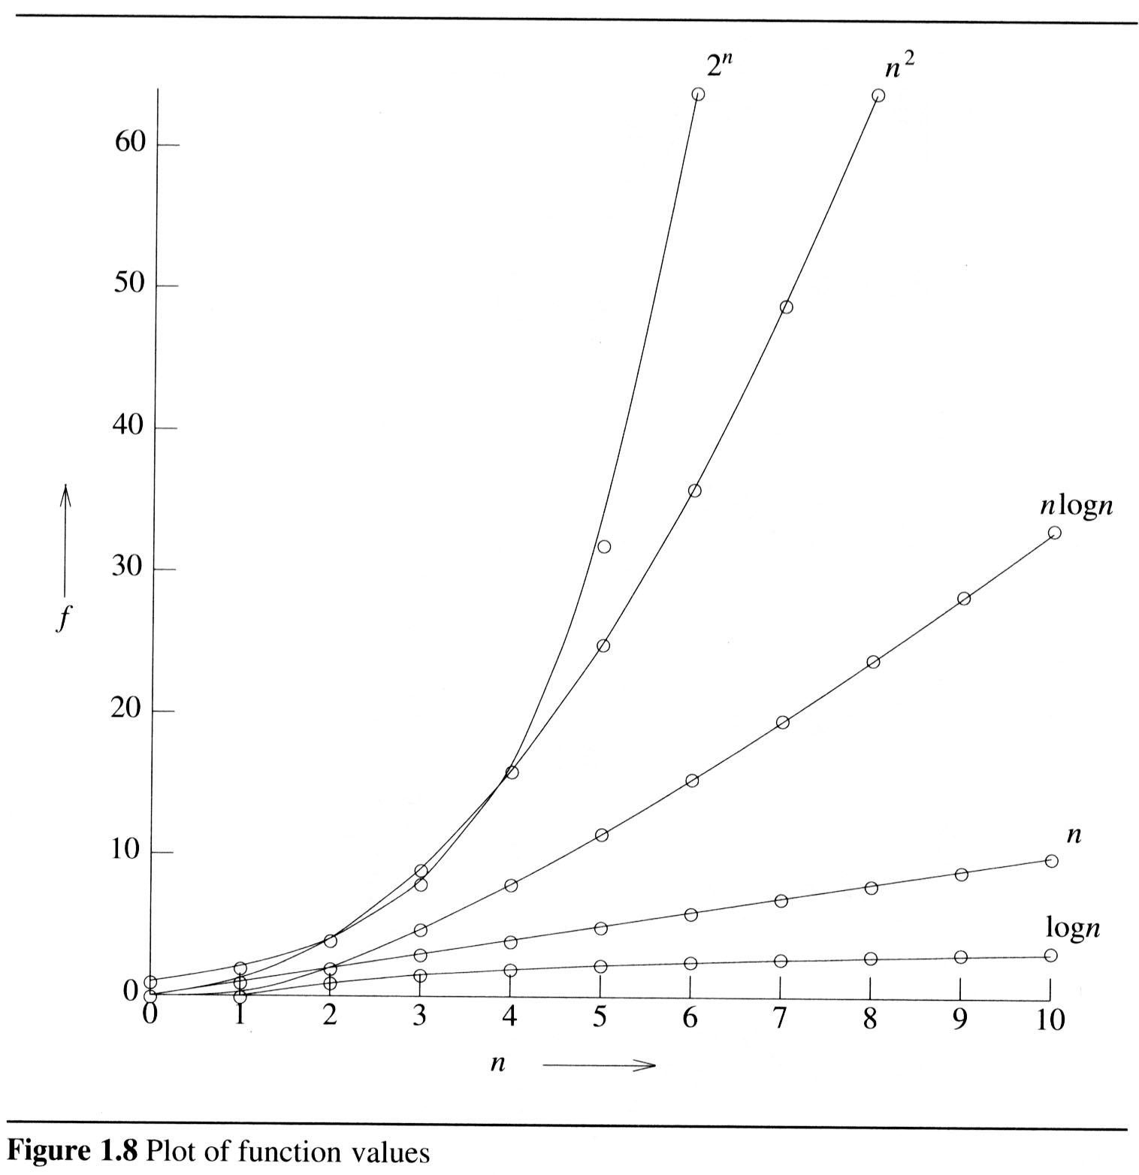
2

Slide 63
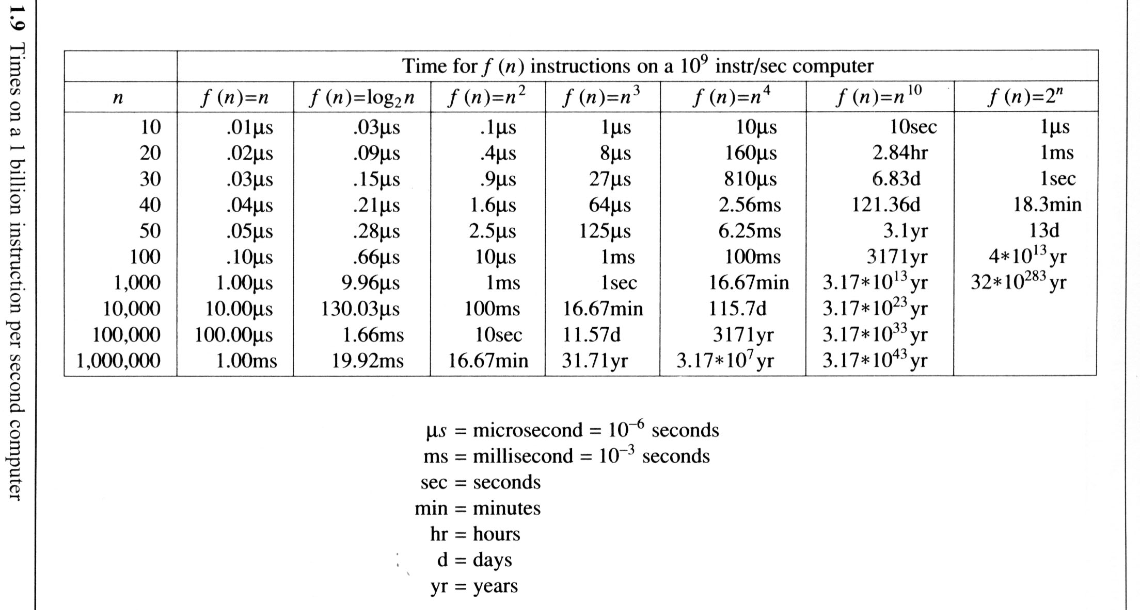
The following fig gives the time needed by a 1 billion instructions per second computer to execute a program of complexity f(n) instructions.

Slide 64
Probabilistic analysis

Slide 65
The Hiring Problem
You are using an employment agency to hire a new assistant.
The agency sends you one candidate each day.
You interview the candidate and must immediately decide whether or not to hire that person. But if you hire, you must also fire your current office assistant—even if it’s someone you have recently hired.
Cost to interview is c_{i} per candidate.
Cost to hire is c_{h} per candidate.
You want to have, at all times, the best candidate seen so far.
When you interview a candidate who is better than your current assistant, you fire the current assistant and hire the candidate.
You will always hire the first candidate that you interview.
Problem: What is the cost of this strategy?

Slide 66
Pseudo-code to Model the Scenario
Hire-Assistant (n)
best ← 0 ;;Candidate 0 is a least qualified candidate
for i ← 1 to n
do interview candidate i
if candidate i is better than candidate best
then best ← i
hire candidate i
Cost Model:
We are not concerned with the running time of Hire-Assistant.
We want to determine the total cost of hiring the best candidate.
If n candidates interviewed and m hired, then cost is nc_{i}+mc_{h}.
Have to pay nc_{i} to interview, no matter how many we hire.
So, focus on analyzing the hiring cost mc_{h}.
m varies with order of candidates.

Slide 67
Best-Case Analysis
Best case is when the agency sends you the best applicant on the first day.
Cost is nc_{i}+c_{h}.

Slide 68
Worst-case Analysis
In the worst case, we hire all n candidates.
This happens if each candidate is better than all those who came before. Candidates come in increasing order of quality.
Cost is nc_{i}+nc_{h}.
If this happens, we fire the agency.
What should happen in the average case?

Slide 69
Probabilistic analysis
Probabilistic analysis is the use of probability in the analysis of problems.
Generally, we use probabilistic analysis to analyze the running time of an algorithm.
Sometimes, we can also use it to analyze quantities such as the hiring cost in procedure Hire-Assistant.

Slide 70
Hiring problem-Average –case Analysis
An input to the hiring problem is an ordering of the n applicants, there are n! different inputs.
To use probabilistic analysis, we assume that the candidates arrive in a random order .
Then we analyze our algorithm by computing an expected running time.
The expectation is taken over the distribution of the possible inputs.
Thus, we are averaging the running time over all possible inputs.

Slide 71
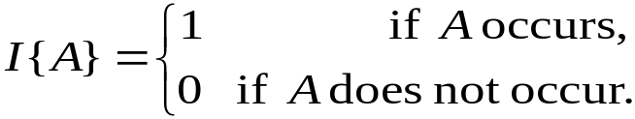
Indicator Random Variable
A powerful technique for computing the expected value of a random variable.
Convenient method for converting between probabilities and expectations.
Takes only 2 values, 1 and 0.
Indicator Random Variable X_{A}=I{A} for an event A of a sample space is defined as:
The expected value of an indicator Random Variable associated with an event A is equal to the probability that A occurs.

Slide 72
Indicator RV – Example1
Problem: Determine the expected number of heads in one coin flip.
Sample space is s{ H,T}
Indicator random variable
X_{A}= I{ coin coming up with heads}=1/2
The expected number of heads obtained in one flip of the coin is equal to the expected value of indicator random variable.
Therefore, E[X_{A}] = 1/2

Slide 73
Indicator RV – Example2
Problem: Determine the expected number of heads in n coin flips.
Let X be the random variable denoting the total number of heads in n coin flips.
Define n indicator random variables, X_{i}, 1 ≤ i ≤ n.
Let X_{i} be the indicator random variable for the event that the i^{th} flip results in a Head.
X_{i} = I{the i^{th} flip results in H}
Then X = X₁ + X₂ + …+ X_{n} = ∑_{i=1..n} X_{i}.
E[X_{i}] = Pr{H} = ½, 1 ≤ i ≤ n.
Expected number of heads is
E[X] = E[∑_{i=1..n} X_{i}].
= ∑_{i=1..n} E[ X_{i}] = ∑_{i=1..n} ½ = n/2.

Slide 74
Back to the Hiring Problem
We want to know the expected cost of our hiring algorithm, in terms of how many times we hire an applicant.
Random variable X(s) is the number of applicants that are hired, given the input sequence s.
Indicator random variable X_{i} for applicant i = 1 if applicant i is hired, 0 otherwise.
What is E[X]?

Slide 75
Probability of Hiring i-th Applicant
Probability of hiring i is probability that i is better than the previous i-1 applicants…
  Pr[X_{i} = 1] = 1/i.
Suppose n = 4 and i = 3.
Ex:-Probability that 3rd applicant is better than the 2 previous ones.
1234
1243
1324
1342
1423
1432
2134
2143
2314
2341
2413
2431
3124
3142
3214
3241
3412
3421
4123
4132
4213
4231
4312
4321
8/24 = 1/3

Slide 76
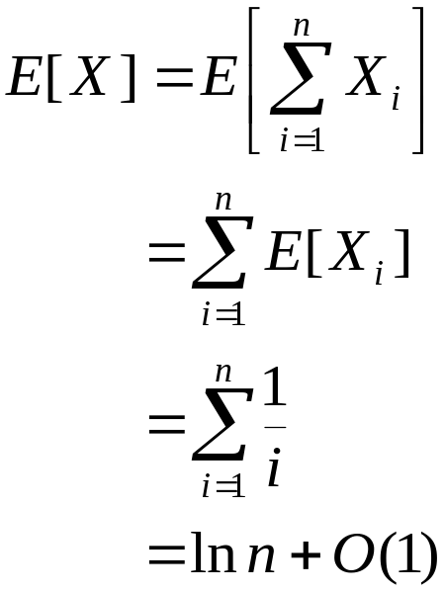
Analysis of the Hiring Problem
Compute E[X], the number of candidates we expect to hire.
1
Expected hiring cost = O(c_{h}ln n).

Slide 77
Amortized Analysis
Data structures are subjected to a sequence of operations rather than one operation.
In this sequence, one operation possibly performs certain modifications that have an impact on the run time of the next operation in the sequence.
One way of assessing the worst case run time of the entire sequence is to add worst case efficiencies for each operation.
This may result in an excessively large and unrealistic time complexity.

Slide 78
Amortized analysis concentrates on finding the average complexity of a worst case sequence of operations.
Amortized analysis considers interdependence between operations.
  For example, if an array is sorted and only a very few new elements are added, then re-sorting this array will be must faster than sorting it for the first time.
You try to estimate an upper bound of the total
work T(n) required for a sequence of n operations…
Some operations may be cheap some may be expensive.
Overall, your algorithm does T(n) of work for n operations …
Therefore, by simple reasoning, the amortized cost of each
operation is T(n)/n

